Slide 1
Searching for TED talks
The Four Searchketeers: Mo, Robin, Carolien & Nadja

Slide 2
Our mission/goal
A good working search engine with...
A ranked list of results
Advanced search
Wordcloud
Timeline
Faceted search

Slide 3
The Data
About 2500 TED talks
For every talk:
Title
Speaker
Occupation of speaker
Transcript
Event
Topics
Minimum views
Maximum views
Film date
Publish date
Minimum duration
Maximum duration

Slide 4

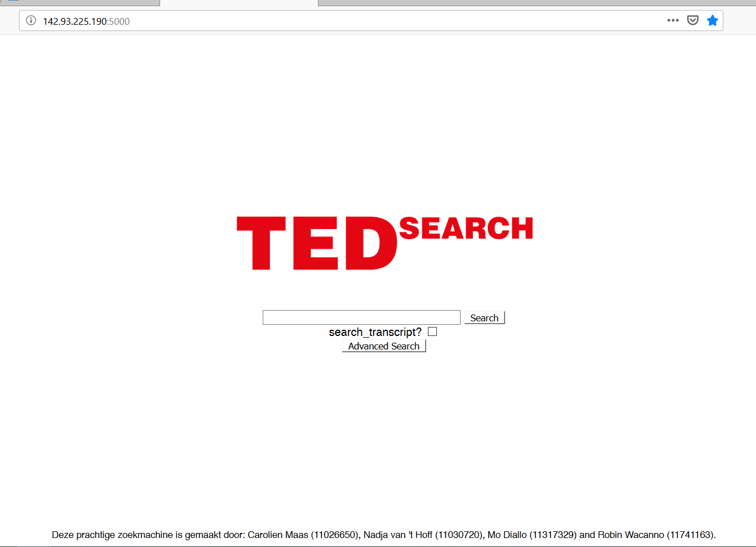
Current
Simple search
Search for everything (except transcript)
Advanced search
Search options in zones

Slide 5
Current
Simple search
Search for everything (except transcript)
Advanced search
Search options in zones

Slide 6
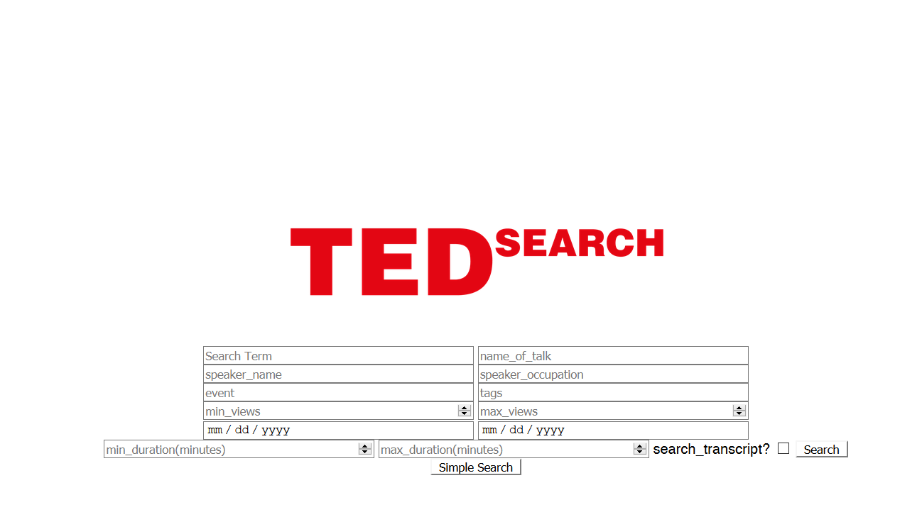

Slide 7
Term

Slide 8
Title of talk

Slide 9
Name of speaker

Slide 10
Job of speaker

Slide 11
Event

Slide 12
Tags

Slide 13
Minimum views
Maximum views

Slide 14
Film date
Publish date

Slide 15
Minimum duration
Maximum duration

Slide 16
Search in transcripts

Slide 17
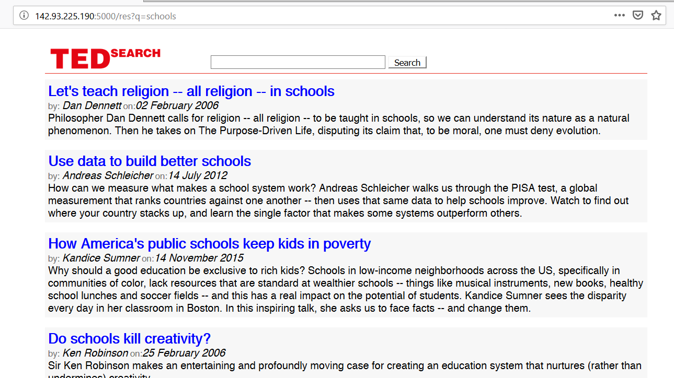
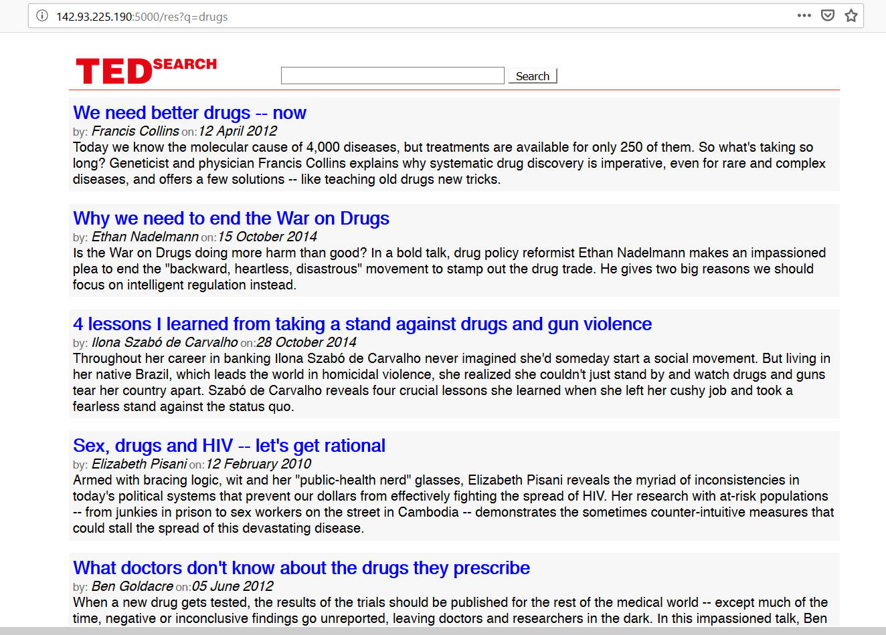

Slide 18
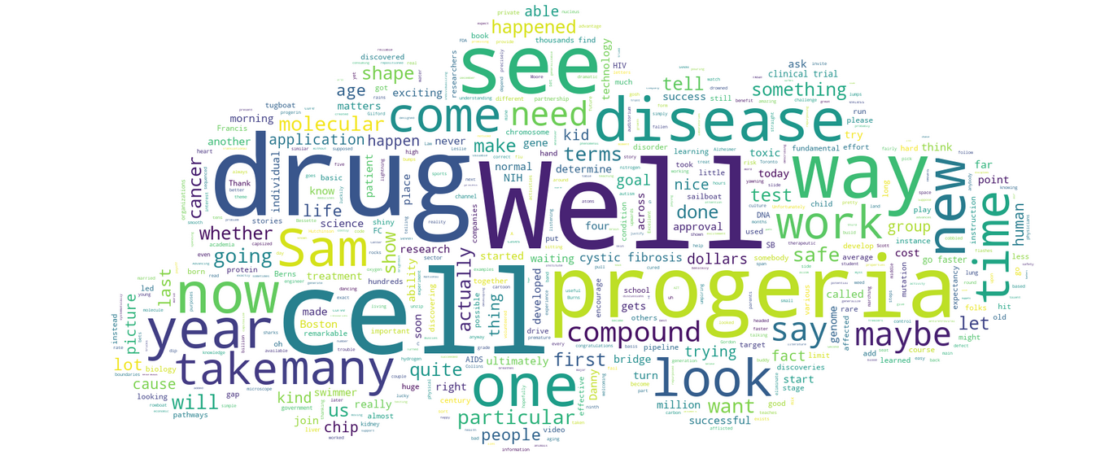
Wordcloud for each TED talk

Slide 19
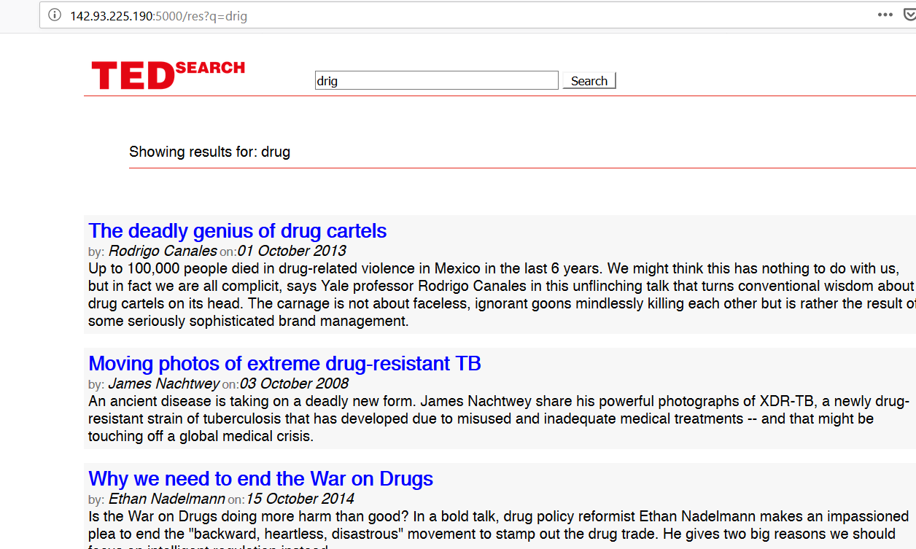
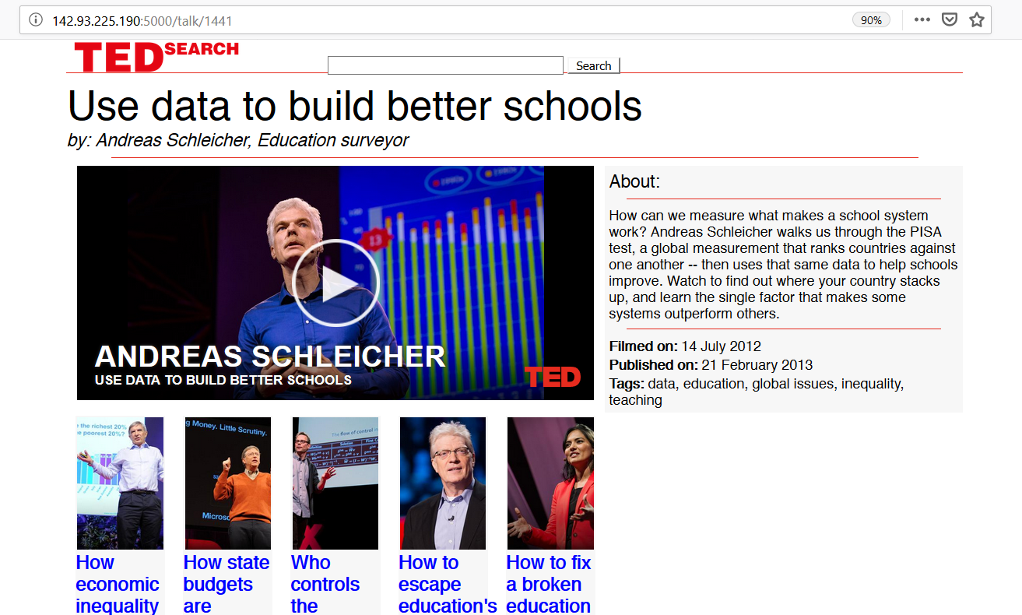
Extra features
Autocorrection
Recommendation of 5 related talks

Slide 20
Current search engine
See it yourself!
Link with query

Slide 21
Problems Challenges
Preparation of the dataset:
Two sets
No identification
Takes some time to load results
Precision of returned results
Q: “Downsides of being a drugs dealer”
4th result: “Could we cure HIV with lasers?”
But: First 2 results mostly relevant
Extra feature is bananas

Slide 22
Want to learn more?

Slide 23
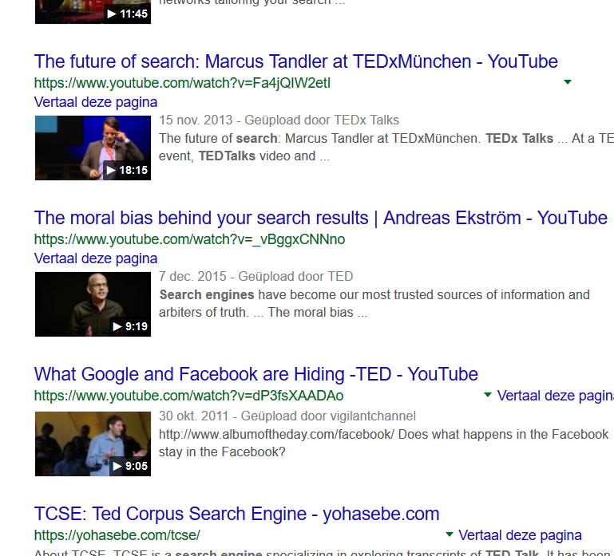

Want to learn more?
Watch TED talks on search engines!
(Or ask us)

